Slide 1
Software Testing and Quality Assurance UNIT-3

Slide 2
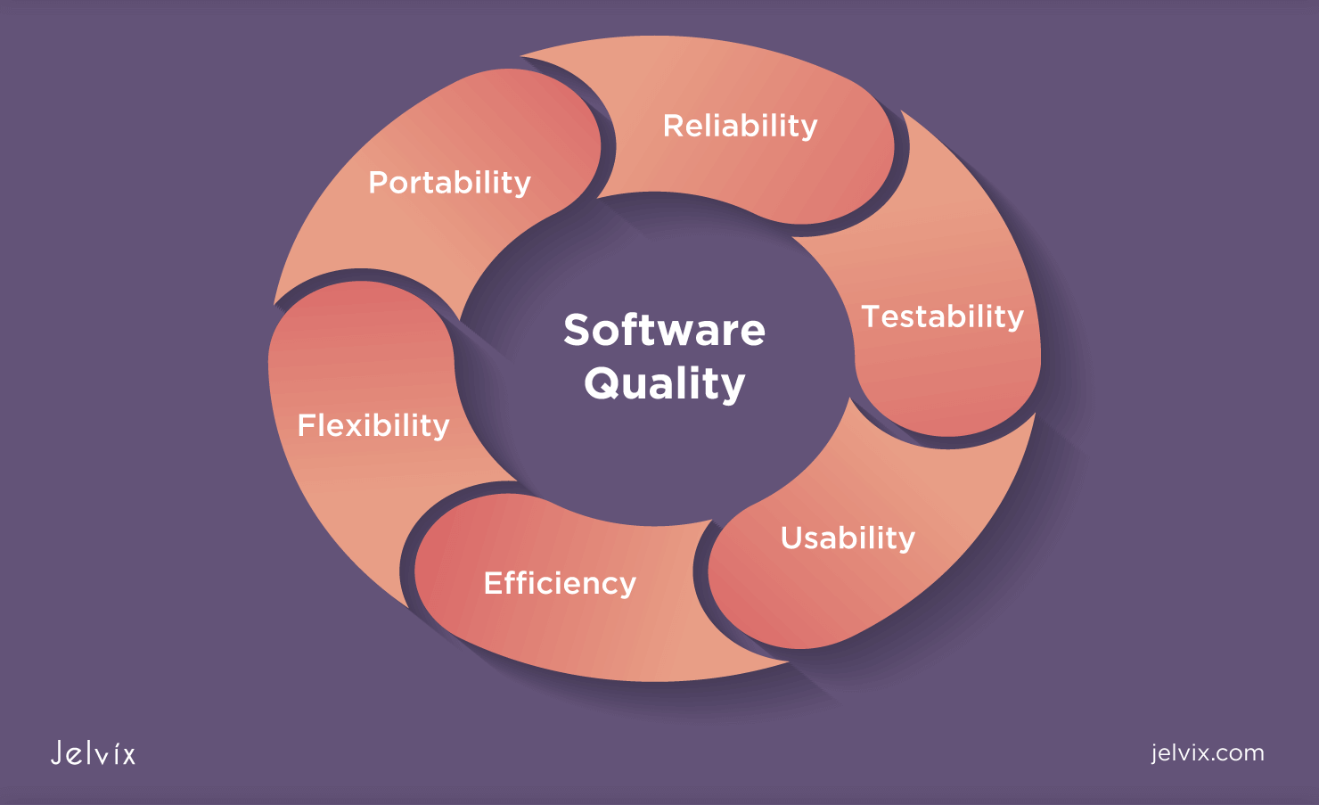
Need For Software Quality
Software systems today are used in critical fields like healthcare, banking, transport, space, and defence.
A small bug can lead to huge losses (e.g., a software bug in a bank might cause financial errors).
Software quality ensures:
Correct functioning
Security from threats
Good performance under load
User satisfaction
Example: Google and Amazon ensure quality to handle millions of users reliably.

Slide 3
Quality Challenges
Quality is hard to achieve due to:
Frequent changes in requirements – Users may update their needs midway.
Time and Budget Constraints – Projects must be completed quickly and cheaply.
Team Skills – A less experienced team might introduce errors.
Technology Integration – Software today must integrate with other systems and platforms.
Lack of defined quality processes – Many teams skip SQA planning.
Example: A mobile app launched quickly without testing might crash on some devices – a quality failure.

Slide 4
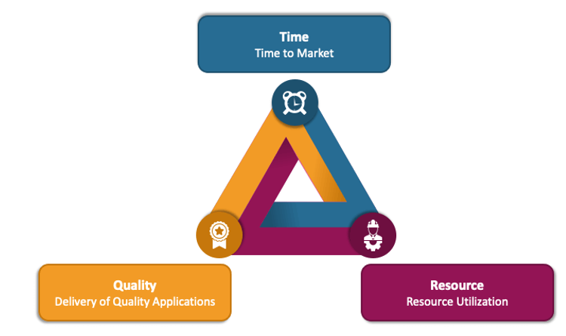
Software Quality Assurance (SQA)
Definition:
SQA refers to the systematic activities that monitor and improve software processes to ensure the final product:
Meets user expectations
Adheres to standards (like ISO 9126, IEEE, CMMI)
Is reliable, secure, and maintainable
SQA is proactive – it prevents defects instead of just fixing them later.

Slide 5
Objectives of SQA
To prevent bugs and errors during development.
To ensure software reliability and efficiency.
To make the process repeatable and consistent using standards.
To ensure customer satisfaction and trust.
To reduce cost and time by catching issues early.

Slide 6
Software Quality Factors (McCall’s 11 Factors)
Category | Factors | What it means
Product Operation | Correctness, Efficiency, Reliability, Integrity, Usability | Is the software doing its job properly and securely?
Product Revision | Maintainability, Flexibility, Testability | Can it be updated, changed, or tested easily?
Product Transition | Portability, Reusability, Interoperability | Can it move, be reused, or integrate with other systems?
Example: A hospital system must be reliable (no crash), secure (data privacy), and maintainable (updates for new diseases).

Slide 7
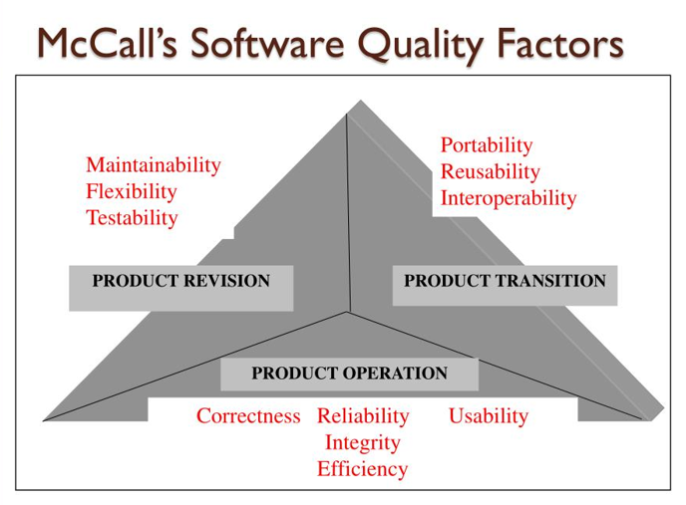

Slide 8
McCall’s Quality Model
This model connects quality factors, criteria, and metrics to evaluate software quality.
It focuses on what the software should do and how well it performs.
Examples:
Correctness → Does it meet requirements? ✔ Measured by defect density (e.g., number of bugs)
Efficiency → Does it use memory/CPU well? ✔ Measured by performance tools (e.g., CPU/memory usage reports)
Real-world Example:
Imagine you're using a mobile banking app:
If it displays the correct balance and allows secure transactions, that shows Correctness.
If it loads quickly and doesn’t freeze or drain your battery, that reflects Efficiency.

Slide 9

SQA System and Architecture
The SQA (Software Quality Assurance) system is designed to ensure that software products meet certain quality standards. It involves a structured approach that integrates various components to guarantee software quality at every stage of the development lifecycle.

Slide 10
Key Components of the SQA System:
Standards and Guidelines These define the quality expectations and best practices for software development. Examples include:
ISO (International Organization for Standardization): Provides general standards for software development processes.
CMMI (Capability Maturity Model Integration): Focuses on improving software development processes.
IEEE (Institute of Electrical and Electronics Engineers): Defines standards for software engineering practices.
Audits and Reviews These processes help identify flaws early in the development cycle. They ensure the software follows best practices and meets the required quality standards:
Peer Reviews: Colleagues review each other's code to find defects and suggest improvements.
Technical Audits: An independent audit evaluates the technical aspects of the software for compliance with standards.

Slide 11
Key Components of the SQA System:
Testing Strategies Different levels of testing are used to ensure software is functioning correctly:
Unit Testing: Tests individual components or functions of the software.
Integration Testing: Tests interactions between different software modules.
System Testing: Verifies the software works as a whole.
Acceptance Testing: Confirms if the software meets the business requirements and is ready for release.
Defect Management System A tool to track and manage bugs and defects in the software. JIRA is a commonly used tool for tracking defects and progress through various stages of resolution.

Slide 12
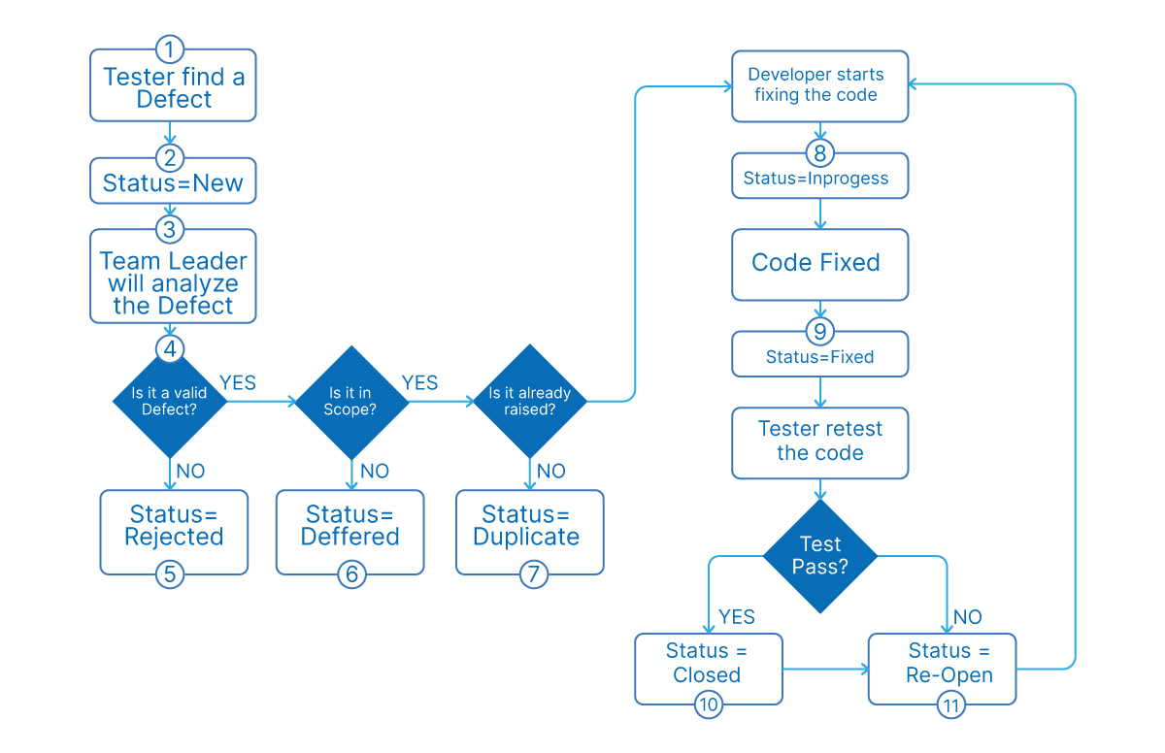

Slide 13
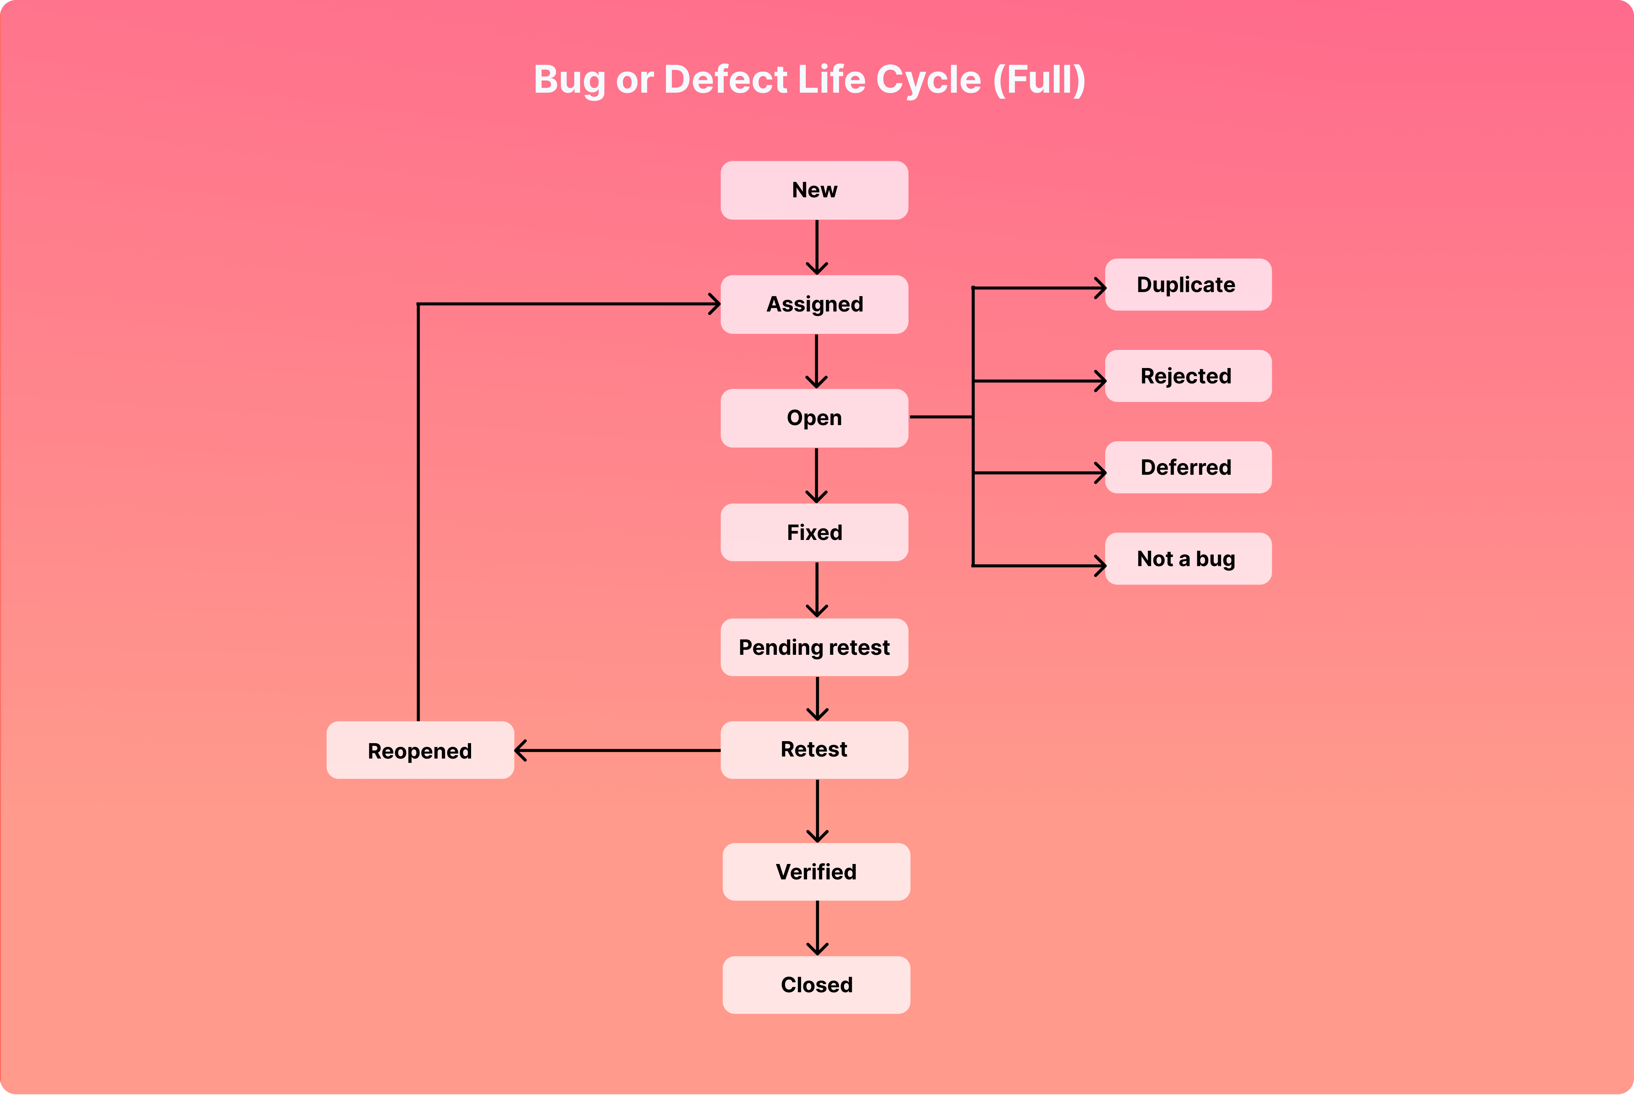

Slide 14
Key Components of the SQA System:
Metrics Collection SQA systems track key metrics to assess software quality:
Code Quality: Metrics like cyclomatic complexity, code duplication, etc.
Bug Frequency: How often bugs occur and how they are fixed.
Test Coverage: Percentage of code covered by tests.
Tools & Automation These tools help automate the testing and management process, improving efficiency and reducing human errors:
Selenium: A popular tool for automating web application testing.
Git: A version control tool to track and manage changes in code.
Jenkins: A Continuous Integration (CI) and Continuous Deployment (CD) tool for automating the deployment process.
SonarQube: A tool for continuous inspection of code quality, focusing on maintaining code cleanliness and minimizing defects.

Slide 15
Example of an SQA System in Action:
A company may use the following tools and processes within its SQA system:
Agile methodology for iterative development and feedback.
GitHub for version control, managing source code, and collaborating.
Jenkins for automating Continuous Integration and Continuous Deployment (CI/CD), ensuring code is continuously tested and deployed.
SonarQube to track code quality and find potential issues early.
This combination helps ensure that software is developed efficiently while maintaining high-quality standards throughout the process.

Slide 16
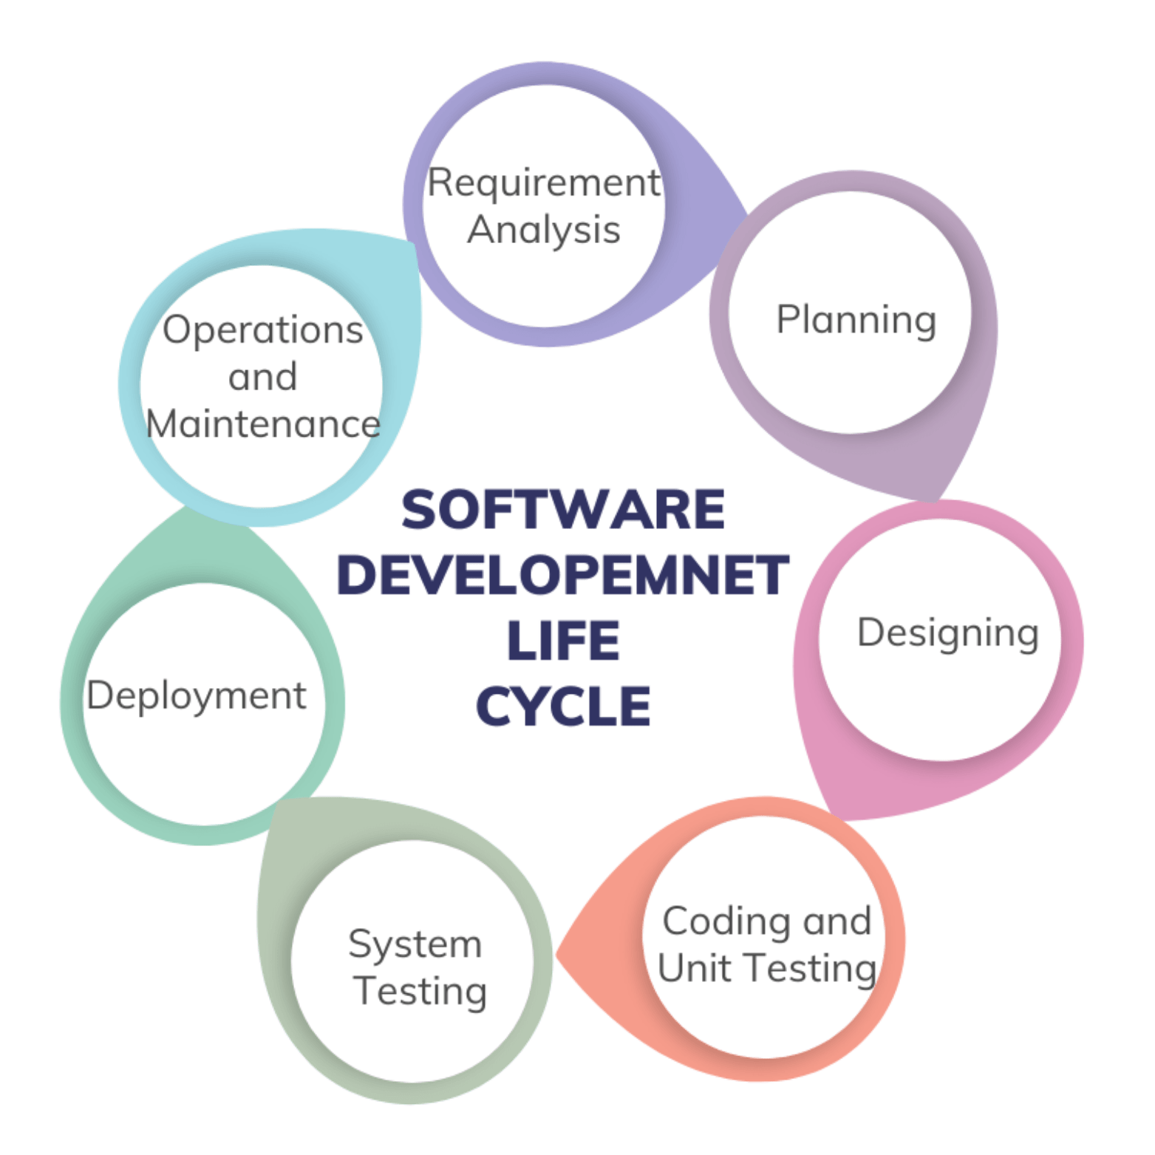
Software Project Life Cycle Components
SQA Activities in the Software Project Life Cycle (SDLC)
The Software Quality Assurance (SQA) process is integrated into every stage of the Software Development Life Cycle (SDLC) to ensure the quality of the final product. Each stage has specific SQA activities designed to identify and resolve issues early.

Slide 17
Requirements Stage:
SQA Activity: Requirement Reviews Explanation: In the requirements phase, SQA ensures the requirements are clear, achievable, and testable. The team checks if the requirements are realistic and well-defined, preventing future misunderstandings.
Example: Reviewing functional and non-functional requirements to make sure they are comprehensive and understandable.
Design Stage
SQA Activity: Design Validation & Architecture Review Explanation: During design, SQA verifies that the software’s architecture meets the project’s requirements and adheres to design best practices. This ensures that the system is structured properly for future changes and scaling.
Example: Reviewing design documents to ensure they are feasible and meet performance, security, and maintainability standards.

Slide 18
Implementation Stage
SQA Activity: Coding Standards & Code Reviews Explanation: At the implementation stage, SQA ensures that developers follow coding standards to maintain consistency and readability. Regular code reviews help identify potential defects early.
Example: Conducting code reviews to find issues such as bugs, inefficiencies, or potential security risks.
Testing Stage
SQA Activity: Functional & Non-Functional Testing Explanation: In the testing phase, SQA checks both functional and non-functional aspects of the software. Functional testing ensures the software performs its expected tasks, while non-functional testing assesses performance, security, and reliability.
Example: Conducting load tests to see how the software performs under heavy traffic and running security tests to check for vulnerabilities.

Slide 19
Deployment Stage
SQA Activity: Configuration Audits Explanation: During deployment, SQA audits the configuration to ensure that the deployment process is followed correctly and that the software is set up in the production environment as intended.
Example: Verifying that the server configurations and database settings are accurate before deployment.
Maintenance Stage
SQA Activity: Regression Testing & Change Control Explanation: In the maintenance stage, SQA ensures that changes (like bug fixes or new features) do not introduce new defects. Regression testing is done to check if the previously working functionality is still intact after updates.
Example: Testing the entire application after a patch or update to ensure no existing features are broken.

Slide 20
Management of SQA Components
The Management of SQA (Software Quality Assurance) involves overseeing the implementation of quality processes and ensuring the team adheres to best practices throughout the software development lifecycle.
It involves key activities such as planning, coordination, monitoring, and measurement to ensure quality is not compromised.

Slide 21
Key Components of SQA Management:
Planning
Definition: The planning phase involves deciding what tools, methods, and teams will be used to ensure quality throughout the project.
Explanation: This is the first step in the SQA process. The team decides which quality assurance tools (e.g., JIRA, Selenium) and methodologies (e.g., Agile, Waterfall) will be used. It also involves defining roles and responsibilities, including assigning tasks to the SQA team, developers, and testers.
Example: A project might plan to use Agile methodology and tools like JIRA for defect tracking and Selenium for automated testing.
Coordination
Definition: Coordination ensures that various teams (development, testing, auditing) work together harmoniously.
Explanation: Effective coordination is crucial to keep all teams aligned on goals, deadlines, and responsibilities. It involves facilitating communication between different teams to prevent silos and ensure the project progresses smoothly.
Example: The SQA manager organizes regular meetings between developers, testers, and auditors to ensure the project is on track and everyone has the necessary resources.

Slide 22
Key Components of SQA Management:
Monitoring
Definition: Monitoring ensures that all processes and quality practices are being followed as planned.
Explanation: The SQA manager oversees the execution of the planned activities and ensures that teams adhere to quality standards. They check if the testing processes, coding practices, and reviews are being carried out properly at each stage.
Example: During the development phase, the SQA manager checks if developers are following coding standards and if testing is being performed as scheduled.
Measurement
Definition: Measurement involves collecting and analyzing metrics related to the software quality.
Explanation: SQA teams track various metrics such as defect density, test coverage, code quality, and performance. These metrics help in assessing the quality of the software and identifying areas for improvement.
Example: The SQA manager collects data on bug counts, test case pass/fail rates, and code complexity to monitor the quality of the product and assess progress.

Slide 23
Pre-Project Software Quality Components
Before any coding starts, there are several pre-project activities to ensure that the project is set up for quality development. These activities help in understanding the project’s scope, risks, and the best approach for building the software.

Slide 24
Contract Evaluation
What is it? This is the process of reviewing and analyzing the contract with the client or stakeholders to ensure the quality expectations, deliverables, timelines, and responsibilities are clearly defined.
Why is it important? The contract serves as the basis for what the client expects from the project, including quality standards. Clear understanding of these expectations helps to align the SQA processes later in the project.
Example: Ensuring the contract includes clauses for code quality, testing requirements, and maintenance expectations.

Slide 25
Feasibility Study
What is it? This activity assesses whether the software can be built within the given constraints such as time, budget, and resources.
Why is it important? It helps identify any potential roadblocks early on, such as technical limitations or unrealistic timeframes, which could affect the quality of the final product.
Example: The team may conduct a feasibility study to assess whether a specific feature can be developed within the project's time and resource constraints without compromising on quality.

Slide 26
Risk Analysis
What is it? Risk analysis identifies potential risks and uncertainties that could affect the project, such as technological challenges, resource shortages, or changing client requirements.
Why is it important? By identifying risks early, the team can prepare mitigation strategies and ensure that these risks don’t lead to poor quality outcomes.
Example: A risk analysis might reveal that the software’s integration with a third-party service is a risk if the service is unstable, so additional testing and contingency planning are included.

Slide 27
Technology Selection
What is it? This refers to choosing the right technology stack (programming languages, frameworks, tools, etc.) based on the project’s needs.
Why is it important? The technology selected must support the desired quality levels, scalability, and performance. Choosing the wrong technology can lead to unnecessary challenges, making it difficult to deliver a quality product.
Example: Selecting React for front-end development and Node.js for backend services because these technologies are best suited to handle expected traffic and scalability needs while supporting high-quality standards.

Slide 28
Project Planning
What is it? Project planning includes the development of a detailed project plan that outlines key milestones, timelines, and roles within the team.
Why is it important? Proper planning ensures that quality milestones (e.g., test completion, code reviews) are incorporated into the project schedule. It also helps in setting clear roles and responsibilities for team members, including who is responsible for quality assurance activities.
Example: The project plan includes deadlines for unit testing, code reviews, and user acceptance testing (UAT) to ensure quality checks are done regularly throughout the development process.

Slide 29
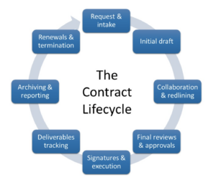
Contract Review
What is it? A contract review is the process of thoroughly analyzing and evaluating the terms of the contract before signing it. The purpose is to ensure that both parties (the client and the software development team) clearly understand the expectations, obligations, and scope of work.

Slide 30
Key Elements of Contract Review:
Ensure Requirements Are Clear and Complete
Explanation: Before signing, all project requirements must be clearly defined and understood by both parties. This includes technical requirements, deadlines, features, and expected outcomes.
Why it matters: If requirements aren’t clear, misunderstandings may arise later, leading to issues with the product quality or client expectations.
Example: The client may specify that the software should allow real-time tracking, and the development team needs to ensure that this feature is technically feasible and well-defined in the contract.
Verify That the Scope Is Realistic
Explanation: The scope of the project should be practical and achievable within the specified timeframe and budget. The contract should clearly define what is included and what is excluded to avoid scope creep (uncontrolled changes to the project scope).
Why it matters: A realistic scope ensures the development team can meet expectations without over-promising or under-delivering. If the scope is not feasible, the project may run into delays or issues that affect quality.
Example: A company agrees to develop a mobile app with a specific set of features (e.g., user registration, real-time notifications, etc.) within 6 months. The scope is carefully evaluated to ensure it can be delivered within that time frame.

Slide 31
Key Elements of Contract Review:
Confirm Quality, Performance, and Legal Obligations
Explanation: The contract should clearly state any quality standards (such as performance metrics, response times, and security requirements) and legal obligations (like compliance with regulations).
Why it matters: Quality clauses in the contract help ensure that the delivered product meets specific performance and security standards. It also helps avoid any legal issues by confirming that both parties understand and agree to the terms.
Example: A software company may clarify in the contract that the response time of the application should be less than 2 seconds under normal load, and if this isn’t met, the company must address performance issues.

Slide 32
Development and Quality Plans
These are official documents that guide the entire software project, ensuring it runs smoothly and meets both development and quality goals.

Slide 33
Development Plan
The Development Plan is a roadmap for how the project will be developed. It covers the following:
Project Schedule
Explanation: A timeline showing when different tasks and milestones will be completed. It helps the team stay on track and meet deadlines.
Example: The development team may plan to complete the user interface design by week 4 and backend development by week 8.
Tools and Technologies
Explanation: This section specifies the technologies, frameworks, and tools that will be used during development.
Example: The team may decide to use React for frontend development, Node.js for backend, and Git for version control.
Resource Allocation
Explanation: Specifies the human and technical resources required for the project. It includes team members, their roles, and any additional resources like servers or software.
Example: A project manager, UI/UX designer, front-end developer, and back-end developer are allocated specific tasks.
Milestones
Explanation: Key checkpoints in the project where significant progress is reviewed. These milestones ensure the project is on track.
Example: Milestone 1: Completion of UI design. Milestone 2: Alpha testing of the core features.

Slide 34
Quality Plan
The Quality Plan ensures that the software meets the required quality standards and objectives. It includes:
Quality Objectives
Explanation: These are the measurable goals that the software must achieve in terms of quality, such as performance, security, and usability.
Example: The objective may be to ensure the software has a response time of less than 2 seconds.
Standards to Follow
Explanation: Lists the quality standards the project will adhere to, such as ISO 9001 or CMMI.
Example: The project may follow ISO 9001 standards to ensure consistency in quality management.
QA Methods and Tools
Explanation: Describes the quality assurance methods (e.g., manual or automated testing) and the tools (e.g., Selenium for automated testing) that will be used.
Example: The project might use JUnit for unit testing and Selenium for functional testing.
Review and Testing Processes
Explanation: Defines the processes for code reviews, peer reviews, and testing cycles to ensure quality is maintained throughout development.
Example: Code reviews will be held after every sprint, and integration testing will be done after each module is developed.
Quality Metrics
Explanation: These are the measurable indicators used to track quality, such as defect density or code coverage.
Example: One quality metric could be ensuring that the code has at least 80% test coverage.

